Slide 1
TILL NOW…
Datatypes
Lists
Dictionaries
Functions
Recursion
Classes
File handling

Slide 2
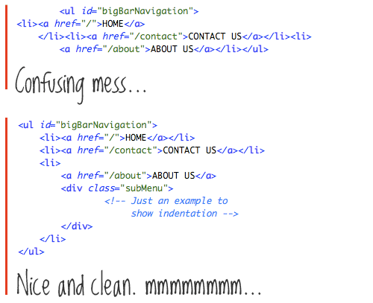
How do we program efficiently?

Slide 3
Good Programs
Correct and Efficient
Easy to read and write
Easy to debug
Easy to modify

Slide 4
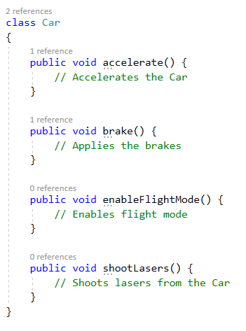
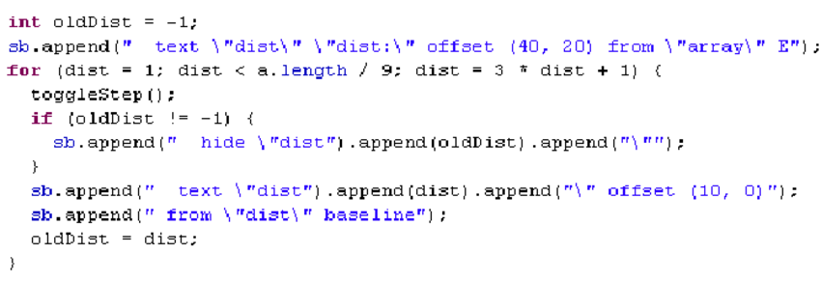
Good Programs
Easy to read and write
Commenting the code
…..

Slide 5
Good Programs
Easy to debug
Divided into short functions
…..

Slide 6
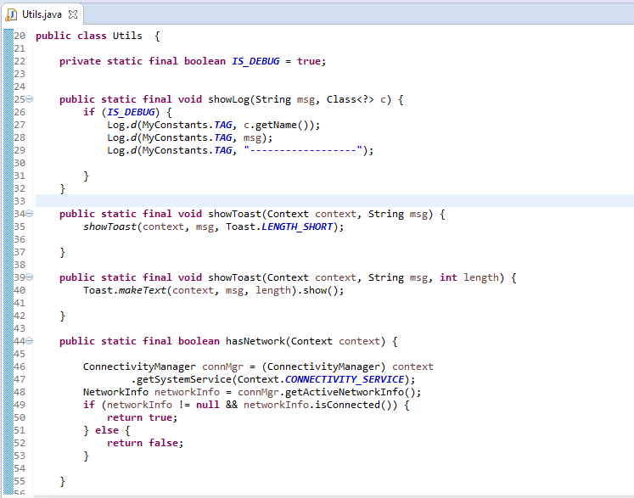
Good Programs
Easy to modify
Generalized functions, classes
…..

Slide 7
Good Programs
Correct and Efficient
Correct: “Run in accordance with specifications”
Efficient: usually Minimum Time, but other constraints such as memory use are also paramount.

Slide 8
Good Programs
Better running times
Generally most appropriate Data Structures and Algorithms
‘hacking’ doesn’t help much
Data is important

Slide 9
Let’s evaluate running times-Compound Interest Program
def raiseToPower(n,k):
if (k == 1):
return n
else:
return n * raiseToPower(n,k-1)
def compountInterest(p, r, t):
return p * raiseToPower((1 + (r/100)), t)
print(compountInterest(10000, 8, 5))

Slide 10
Let’s evaluate running times-Compound Interest Program(math ops)
def compountInterest(p, r, t):
return p * raiseToPower((1 + (r/100)), t)
Time = T_mul

Slide 11
Let’s evaluate running times-Compound Interest Program(math ops)
def raiseToPower(n,k):
if (k == 1):
return n
else:
return n * raiseToPower(n,k-1)
Time = T_mul + T_comp + T_mul (How many times??)

Slide 12
Let’s evaluate running times-Compound Interest Program(math ops)
def raiseToPower(n,k):
if (k == 1):
return n
else:
return n * raiseToPower(n,k-1)
Time = T_mul + (t)T_comp + (t-1)T_mul

Slide 13
Let’s evaluate running times-Compound Interest Program(math ops)
Do we really want to do all of this?
Time = (t) (T_mul + T_comp)

Slide 14
Let’s evaluate running times- We want to study order of growth
T(t) ~ c (Constant time)
T(t) ~ log(t) (Logarithmic time)
T(t) ~ t (Linear time)
T(t) ~ power(t,k) (Polynomial time)
T(t) ~ power(k,t) (Exponential time)

Slide 15

Let’s evaluate running times- BIG OH NOTATION

Slide 16
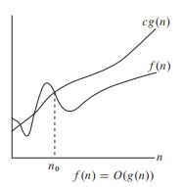
Let’s evaluate running times- BIG OH NOTATION

Slide 17
Let’s evaluate running times- BIG OH NOTATION - exercises

Slide 18

Let’s evaluate running times- BIG OH NOTATION - exercises

Slide 19

Let’s evaluate running times- BIG OH NOTATION - exercises
What is the O(f(n))?

Slide 20
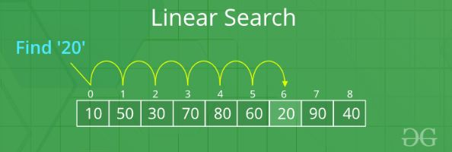
Let’s evaluate running times- BIG OH NOTATION - Linear Search

Slide 21
Let’s evaluate running times- BIG OH NOTATION - Linear Search
def search(arr, n, x):
for i in range (0, n):
if (arr[i] == x):
return i
return -1
Time:
T_loop * n
T_comp * n

Slide 22
Let’s evaluate running times- BIG OH NOTATION - Linear Search
def search(arr, n, x):
for i in range (0, n):
if (arr[i] == x):
return i
return -1
Time ~ (T_comp+T_loop) * n
OR
Time is a function of n and is <= c * n where c is upper limit of the time taken for the operations.
Hence, T(n) is O(n).

Slide 23
Let’s evaluate running times- BIG OH NOTATION - Linear Search
def search(arr, n, x):
for i in range (0, n):
if (arr[i] == x):
return i
return -1
What is worst case complexity?
What is best case complexity?
What is average case complexity?

Slide 24
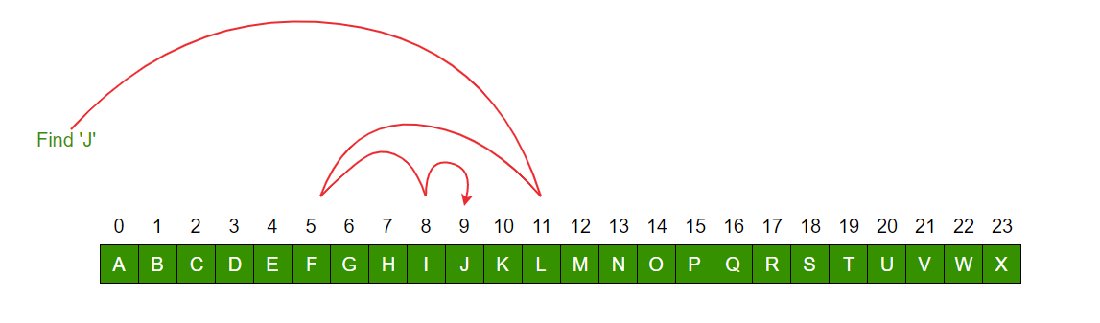
Let’s evaluate running times- BIG OH NOTATION - Binary Search

Slide 25
Let’s evaluate running times - BIG OH NOTATION - Binary Search
def binarySearch (arr, l, r, x):
if r >= l:
mid = l + (r - l)//2
if arr[mid] == x:
return mid
elif arr[mid] > x:
return binarySearch(arr, l, mid-1, x)
else:
return binarySearch(arr, mid+1, r, x)
else:
return -1
Time:
T_comp
T_arith
T_comp
Time/2 (in terms of r)

Slide 26
Let’s evaluate running times - BIG OH NOTATION - Binary Search
def binarySearch (arr, l, r, x):
if r >= l:
mid = l + (r - l)//2
if arr[mid] == x:
return mid
elif arr[mid] > x:
return binarySearch(arr, l, mid-1, x)
else:
return binarySearch(arr, mid+1, r, x)
else:
return -1
T(r) = T(r/2) + a1
This forms a recursive series.
T(r/2) = T(r/4) + a2
….

Slide 27
Let’s evaluate running times - BIG OH NOTATION - Binary Search
def binarySearch (arr, l, r, x):
if r >= l:
mid = l + (r - l)//2
if arr[mid] == x:
return mid
elif arr[mid] > x:
return binarySearch(arr, l, mid-1, x)
else:
return binarySearch(arr, mid+1, r, x)
else:
return -1
Finally, we get
T(r) =
Sigma
(i from 1 to logr)
ai
T(r) <= max(ai)logr
Hence,
T(r) is O(log(r))

Slide 28
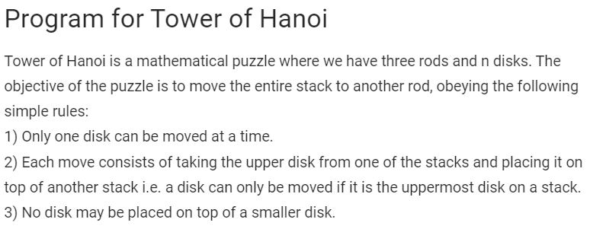
Let’s evaluate running times- BIG OH NOTATION - exercises
TOWER OF HANOI

Slide 29
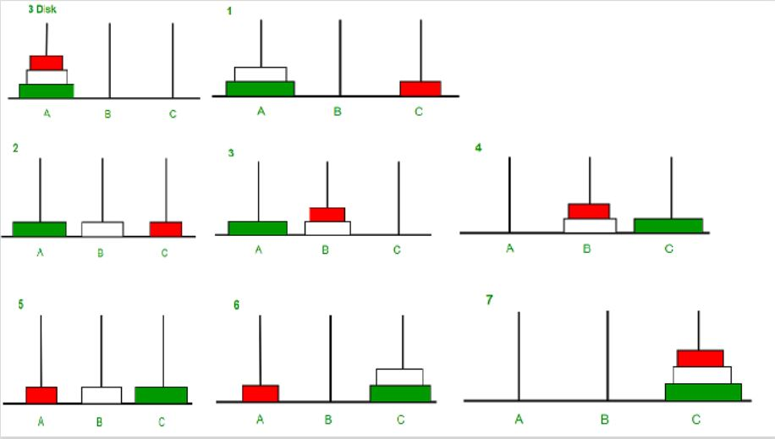
Let’s evaluate running times- BIG OH NOTATION - exercises
TOWER OF HANOI

Slide 30
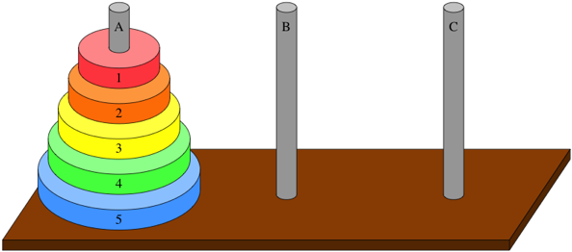
Let’s evaluate running times- BIG OH NOTATION - exercises
TOWER OF HANOI-Hint. What is it’s complexity?

Slide 31
SORTING ALGORITHMS

Slide 32
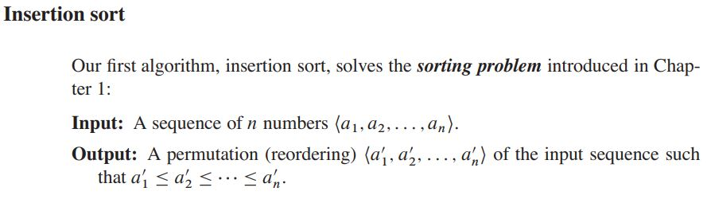
Sorting Problem

Slide 33
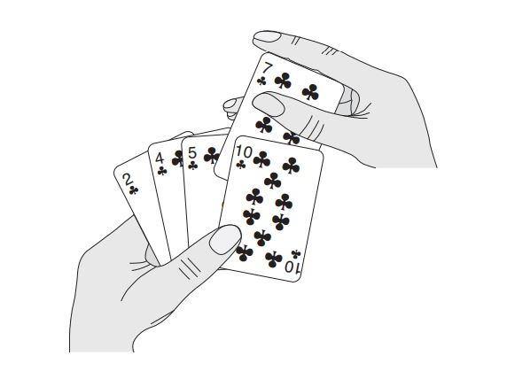
Insertion Sort

Slide 34
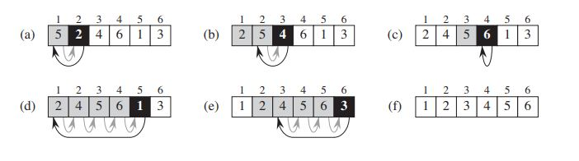
Insertion Sort

Slide 35
Insertion Sort
def insertionSort(arr):
for i in range(1, len(arr)):
key = arr[i]
# Move elements of arr[0..i-1], that are
# greater than key, to one position ahead
# of their current position
j = i-1
while j >= 0 and key < arr[j] :
arr[j + 1] = arr[j]
j -= 1
arr[j + 1] = key

Slide 36
Insertion Sort
def insertionSort(arr):
for i in range(1, len(arr)):
key = arr[i]
# Move elements of arr[0..i-1], that are
# greater than key, to one position ahead
# of their current position
j = i-1
while j >= 0 and key < arr[j] :
arr[j + 1] = arr[j]
j -= 1
arr[j + 1] = key

